Slide 1
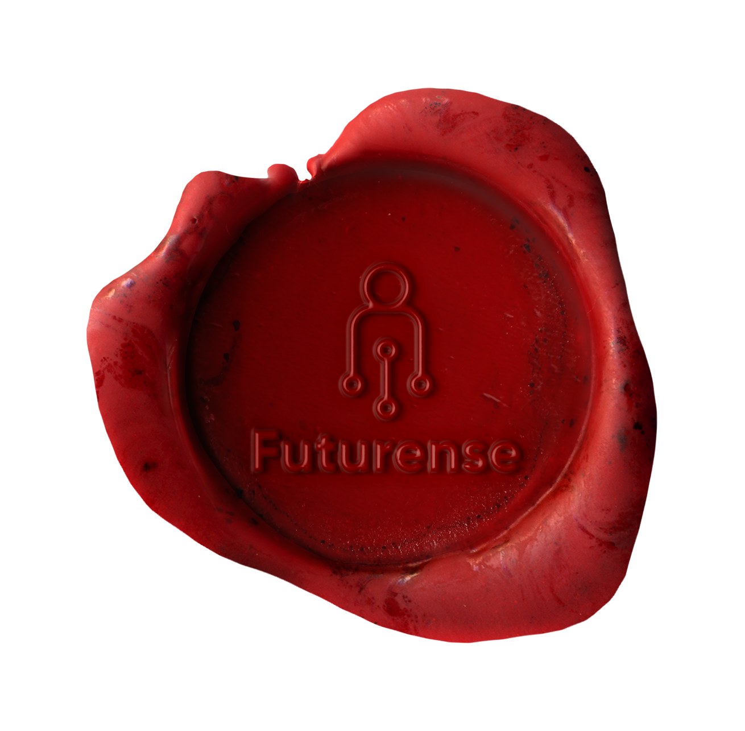
Futurense
Democratizing Tech Talent to deliver impact at scale

Slide 2
HealthCare EDA
Presented by:
Abhishek Yadav
FT632

Slide 3
Overview:
Description: An efficient health care system can contribute to a significant part of a country's economy, development, and industrialization.
Business Problem: Analyse India’s health sector and suggest solutions to match that one with WHO standard

Slide 4
Libraries/Packages Used:
Geopandas
Matplotlib
Pandas
Seaborn

Slide 5




Tools and Technologies Used:

Slide 6





Data Source:
Census_2011.csv
Government_hospitals.csv
Hospital.csv
Housing.csv
India_district.geojson*
* https://www.kaggle.com/datasets/krutarthhd/india-geojson-file

Slide 7
Cleaning of Datasets:
Keep only relevant columns
Change columns name to make uniformity across datasets
Rename and format State/UT and District name
Change state name according to new State/UT formation
Change percentage format to actual data in housing dataset
Find and process missing data

Slide 8
Cleaned Datasets:
All_hospital.csv
Census.csv
Government_hospitals.csv
Housing.csv

Slide 9
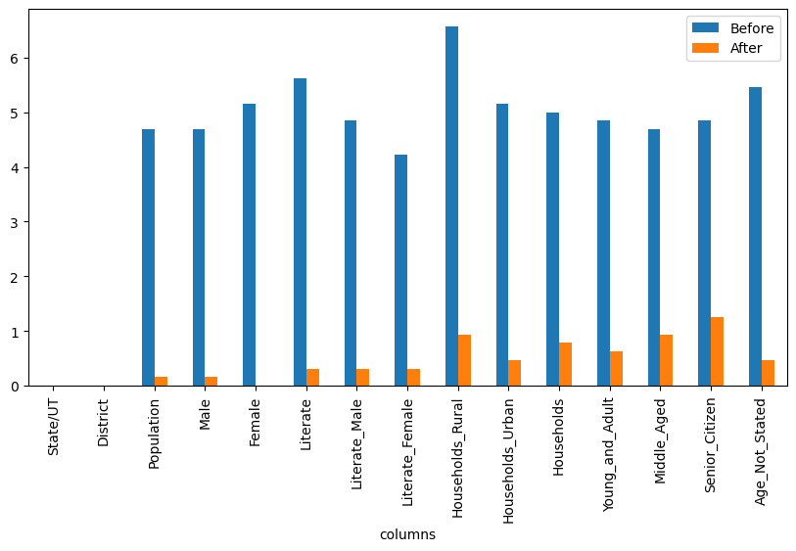
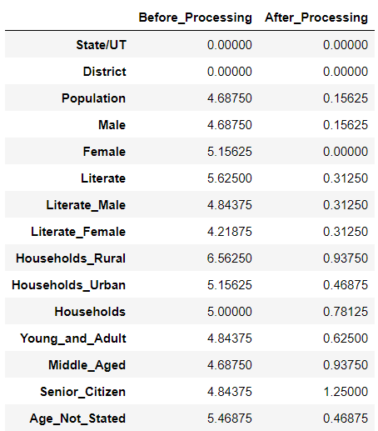
Percentage of missing data:

Slide 10
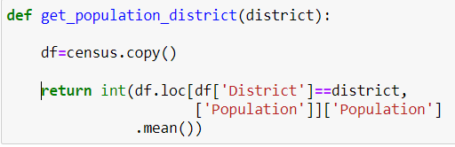
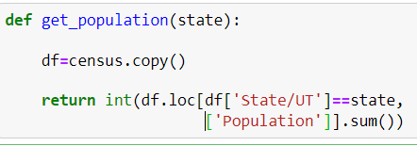
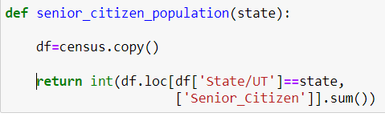
Functions:

Slide 11
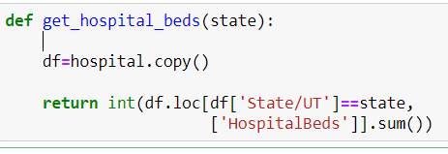
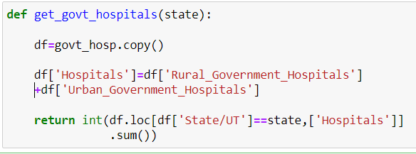
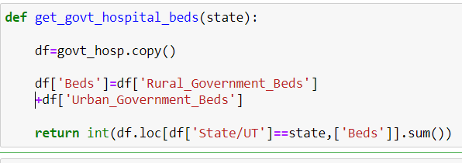
Functions:

Slide 12
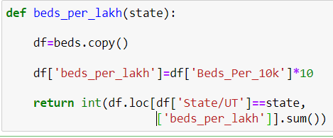
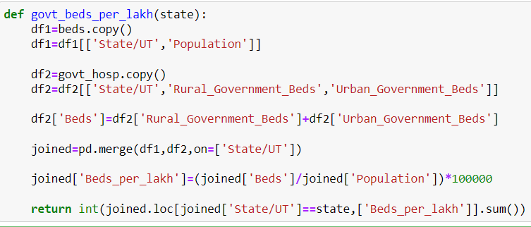
Functions:

Slide 13

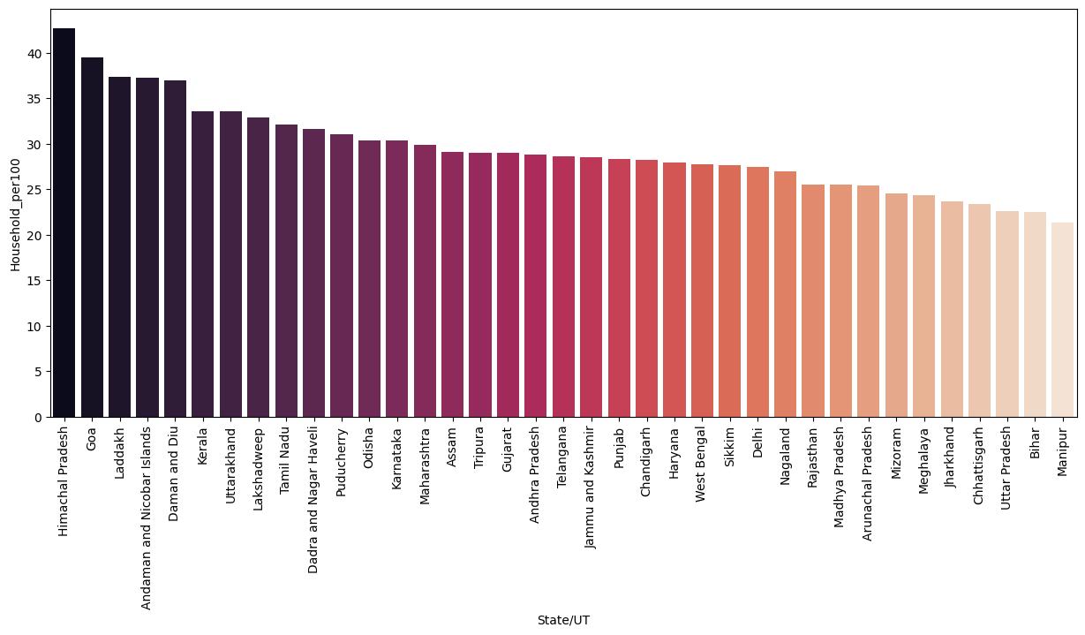
Findings from Census Data:
This graph shows state wise Households for per 100 people.
HP, Goa, Ladakh has highest no of house per 100 people
Manipur, Bihar and UP has lowest no of house per 100 people

Slide 14
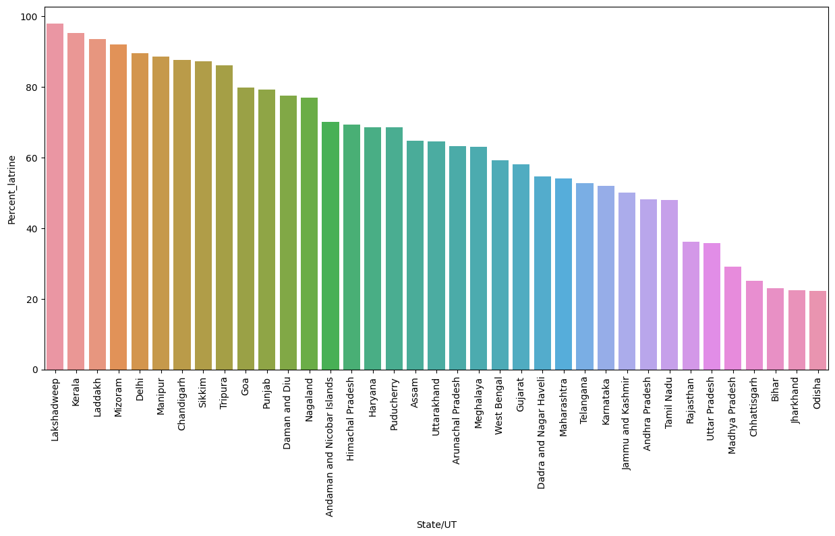
Percentage of households that have toilet in premise
Lakshadweep, Kerala, Ladakh are best performing in this category
Odisha, Jharkhand and Bihar need special attention as there is overall percent is less than 25

Slide 15
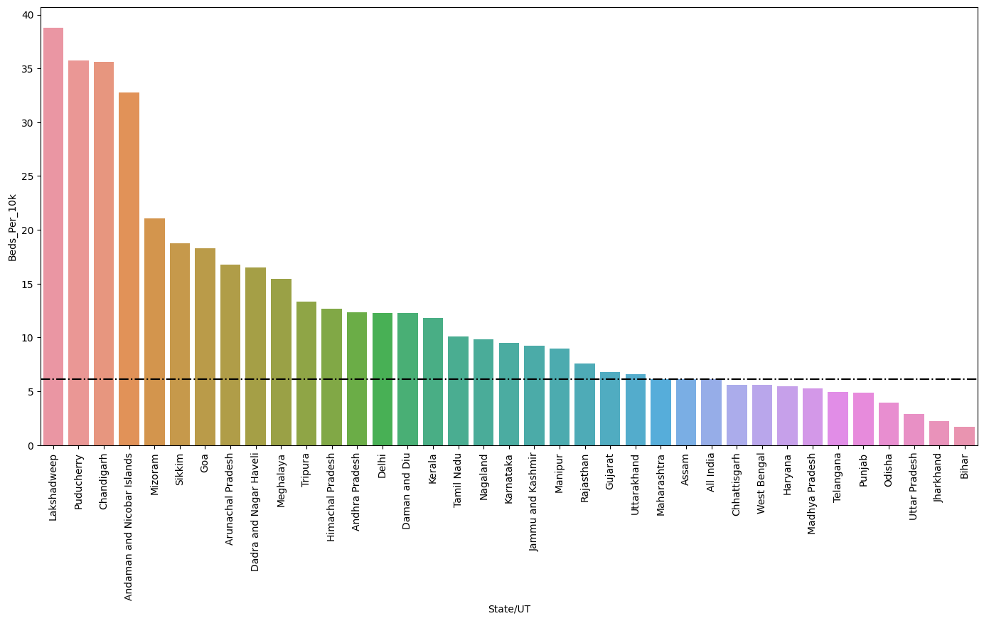
State wise beds per 10k people in hospitals
Black line shows All India average, which is very less as per WHO standards*.
Only Lakshadweep, Puducherry and Chandigarh have more than 30 beds per 10k people that satisfy WHO* standard.
Bihar, Jharkhand and UP are in very critical condition as there is less than 3 beds per 10k people.
* As per World Health Organization(WHO) there should be at least 30 beads per 10000 Peoples.

Slide 16
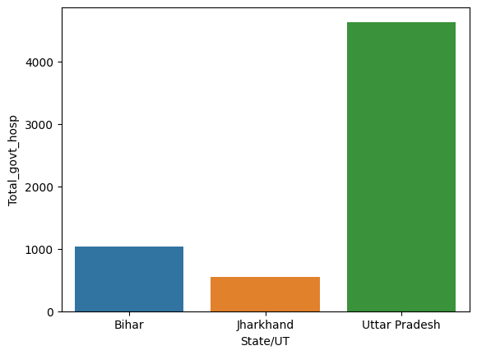
Total Govt. Hospitals in worst 3 states:
Out of These three states Jharkhand has lowest number of hospitals.
We have to open new hospitals in Jharkhand followed by Bihar

Slide 17
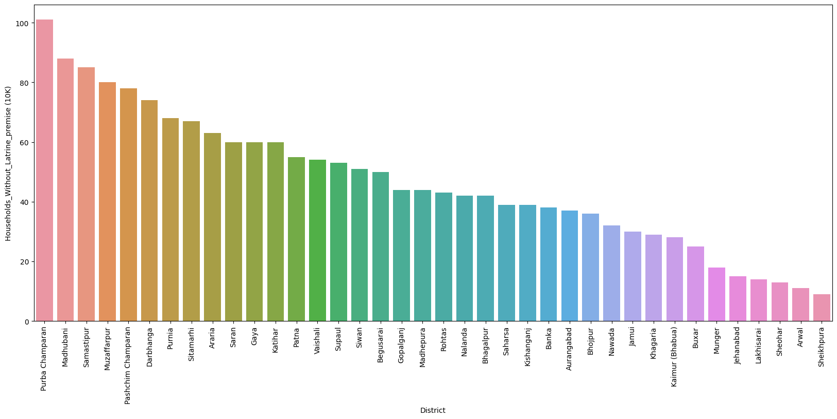
District wise households without toilet (10K) in Bihar
In Purva Champran there are more than 1M households without toilet
Also in Madhubani and Samastipur there are more than 800K households without toilet in premise

Slide 18
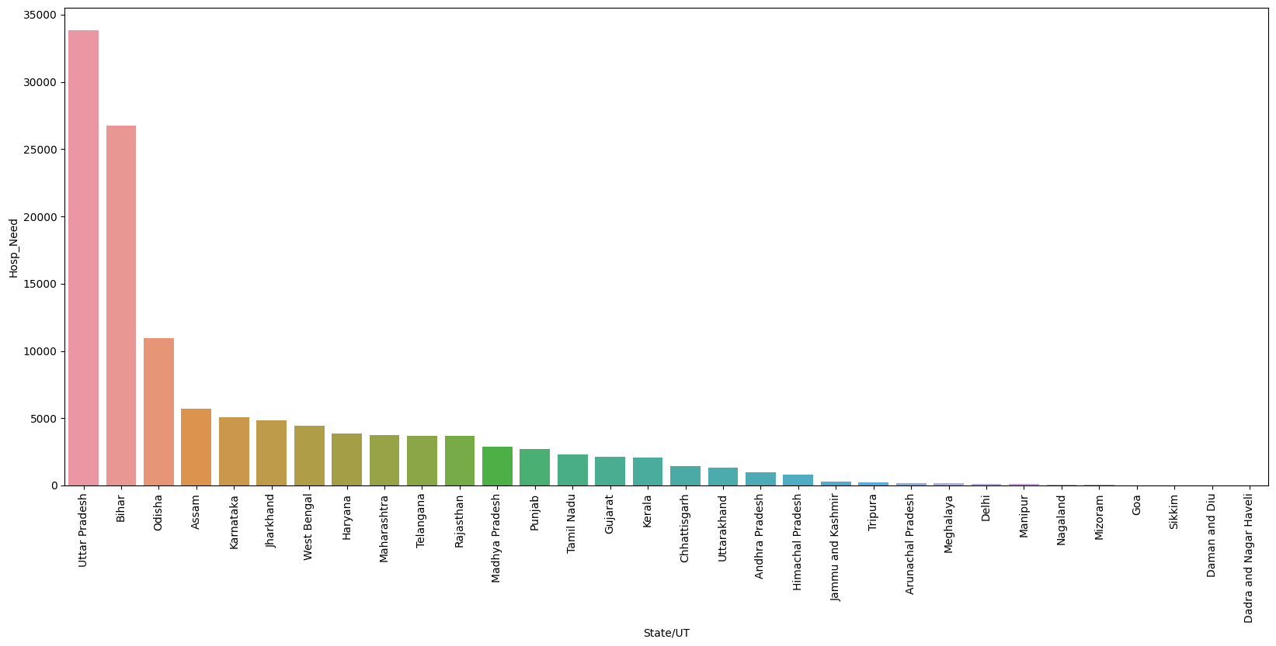

State wise Hospitals needed to match WHO Standards
UP, Bihar need more than 25,000 Hospitals to match WHO standards

Slide 19
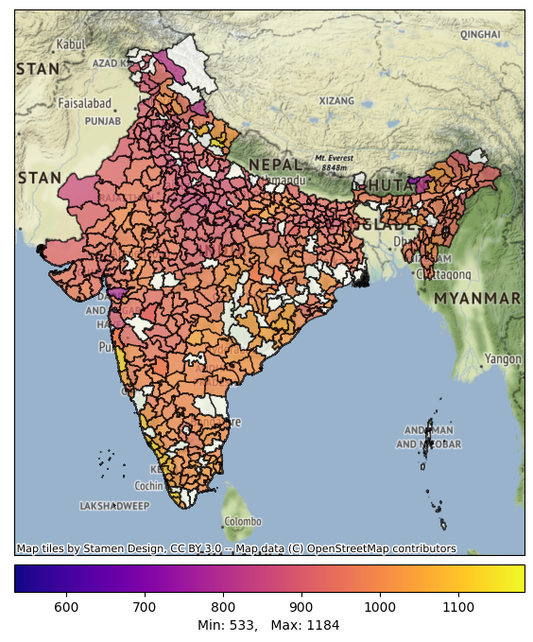
District Wise Sex Ratio
In South region sex ratio is good, even in some areas it is higher than 1000
In middle region (UP) sex ratio is seems lowest.

Slide 20
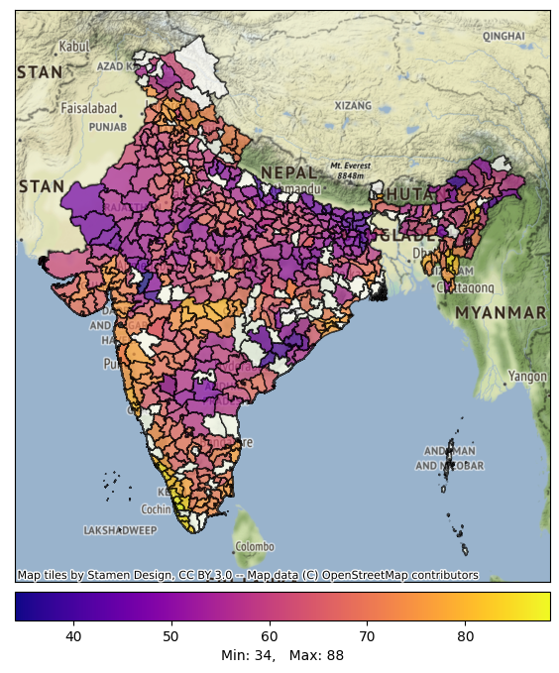
District wise Literacy Percentage:
Overall Literacy Percentage
Male Literacy Percentage
Female Literacy Percentage

Slide 21
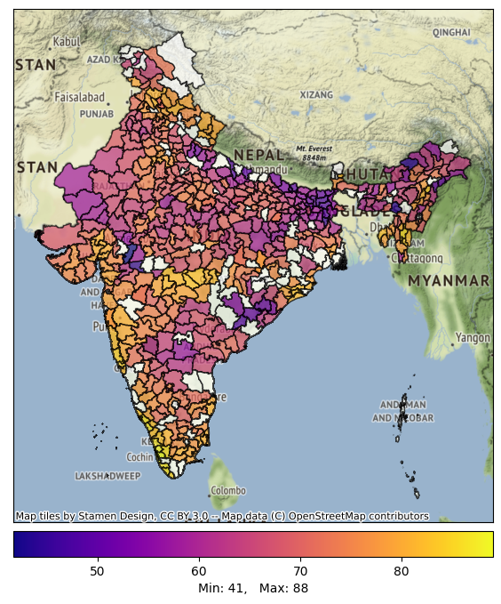
District wise Literacy Percentage:
Overall Literacy Percentage
Male Literacy Percentage
Female Literacy Percentage

Slide 22

District wise Literacy Percentage:
Overall Literacy Percentage
Male Literacy Percentage
Female Literacy Percentage

Slide 23
Observations from Previous slide:
In middle region of India overall literacy percentage is highest.
At international borders literacy percentage is shockingly lowest.
Male literacy percentage is more or less same as overall percentage.
Female literacy rate is drastically low as compare to Male literacy percentage.
Female literacy percentage go as low as 25%.
In Middle region we have to encourage females for education. Specially Rajasthan, UP, Bihar, Jharkhand.

Slide 24
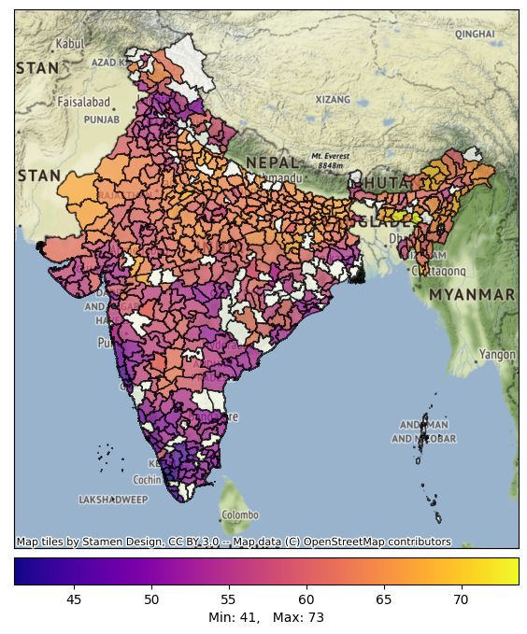
District wise Age distribution:
Young Population percentage
Middle Aged Population percentage
Senior Citizen Population percentage

Slide 25
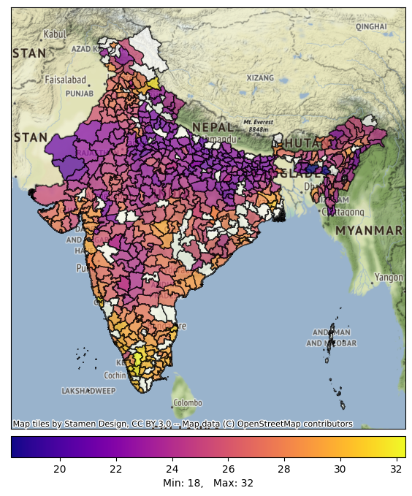
District wise Age distribution:
Young Population percentage
Middle Aged Population percentage
Senior Citizen Population percentage

Slide 26
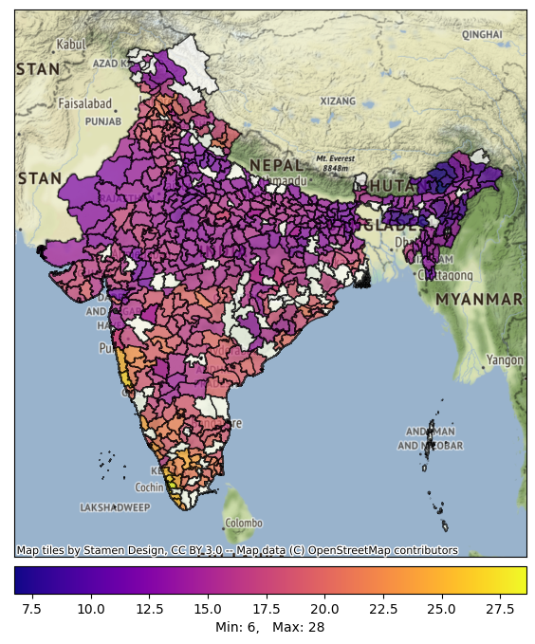
District wise Age distribution:
Young Population percentage
Middle Aged Population percentage
Senior Citizen Population percentage

Slide 27
Observations from Previous slide:
In north and north-east region Young people’s percentage is more than 60% of total population.
In north India middle age people are less likely.
In south region middle aged people are more likely.
In north east Senior Citizens are very low percentage to population, this indicates high death rate in north east region.
We also do not forget one thing: this data is 12 years old. So image is changed so much now.

Slide 28
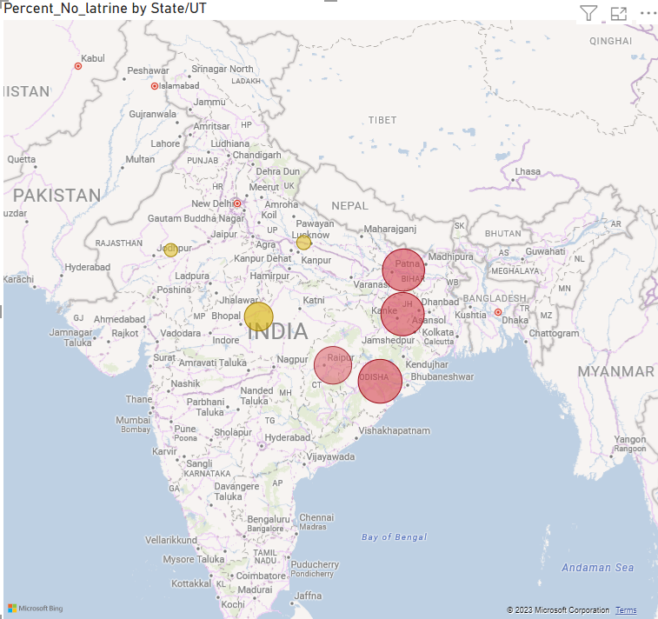
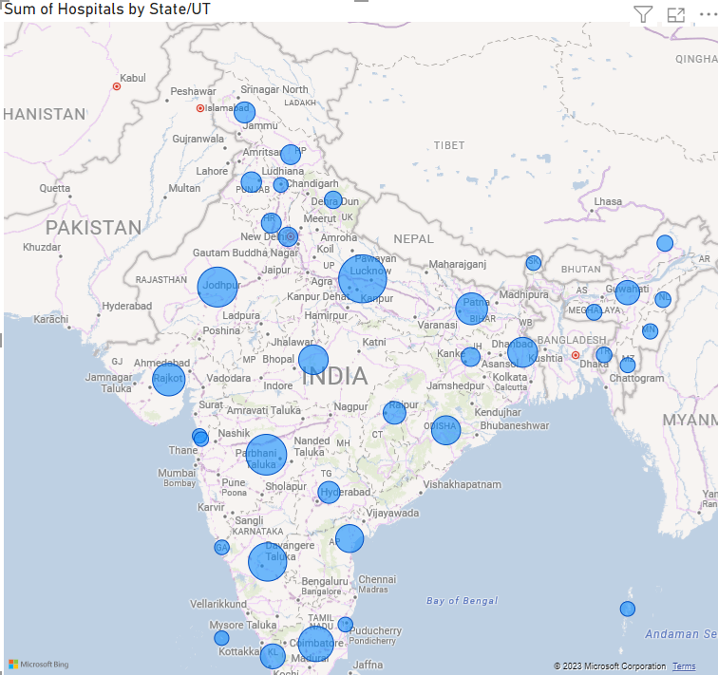
Percent of households that do not have latrine in premise
Total no of Hospitals in a State

Slide 29
Observations from Previous slide:
﻿At 77.79%, Odisha had the highest No toilet in Households.
In East states(Odisha, Jharkhand, Bihar and CG), there is only around 30% households have toilet in premise.
﻿﻿At 4122, Uttar Pradesh had the highest Number of Hospitals that share 11% of total Hospitals.﻿﻿

Slide 30
Overall Findings and Recommendation:
UP and Bihar has very high numbers of hospitals but as they are also highly populated, so average beds per 1K or 10K is very low.
We have to open new hospitals in East regions of India.
We have to improve healthcare quality in North-East region as there is high death rate in that region.
We also have to educate females in UP as there is female literacy percentage is very low.
Also in East region there around only 25% households that have toilet in premise.
Overall East region needs special attention as All states in East region States are underperforming in nearly all aspects.

Slide 31
Thank You

